Slide 1
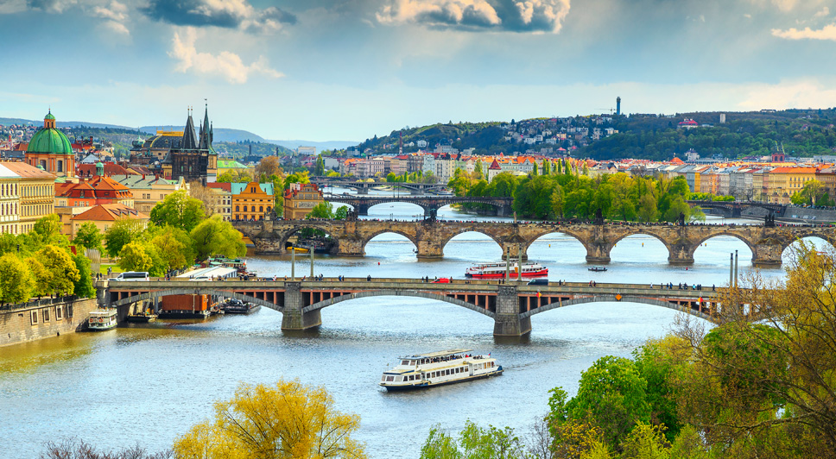
MCHS Orchestras
European music tour information meeting
Wednesday, September 6, 2023

Slide 2
Trip Information
Travel Dates: June 21 – July 2, 2024 (subject to change - depending on flight schedule)
Destination: Prague & Ostrava, Czech Republic and Krakow & Wroclaw, Poland
Invited: All MCHS orchestra students including current seniors and recent orchestra alumni

Slide 3
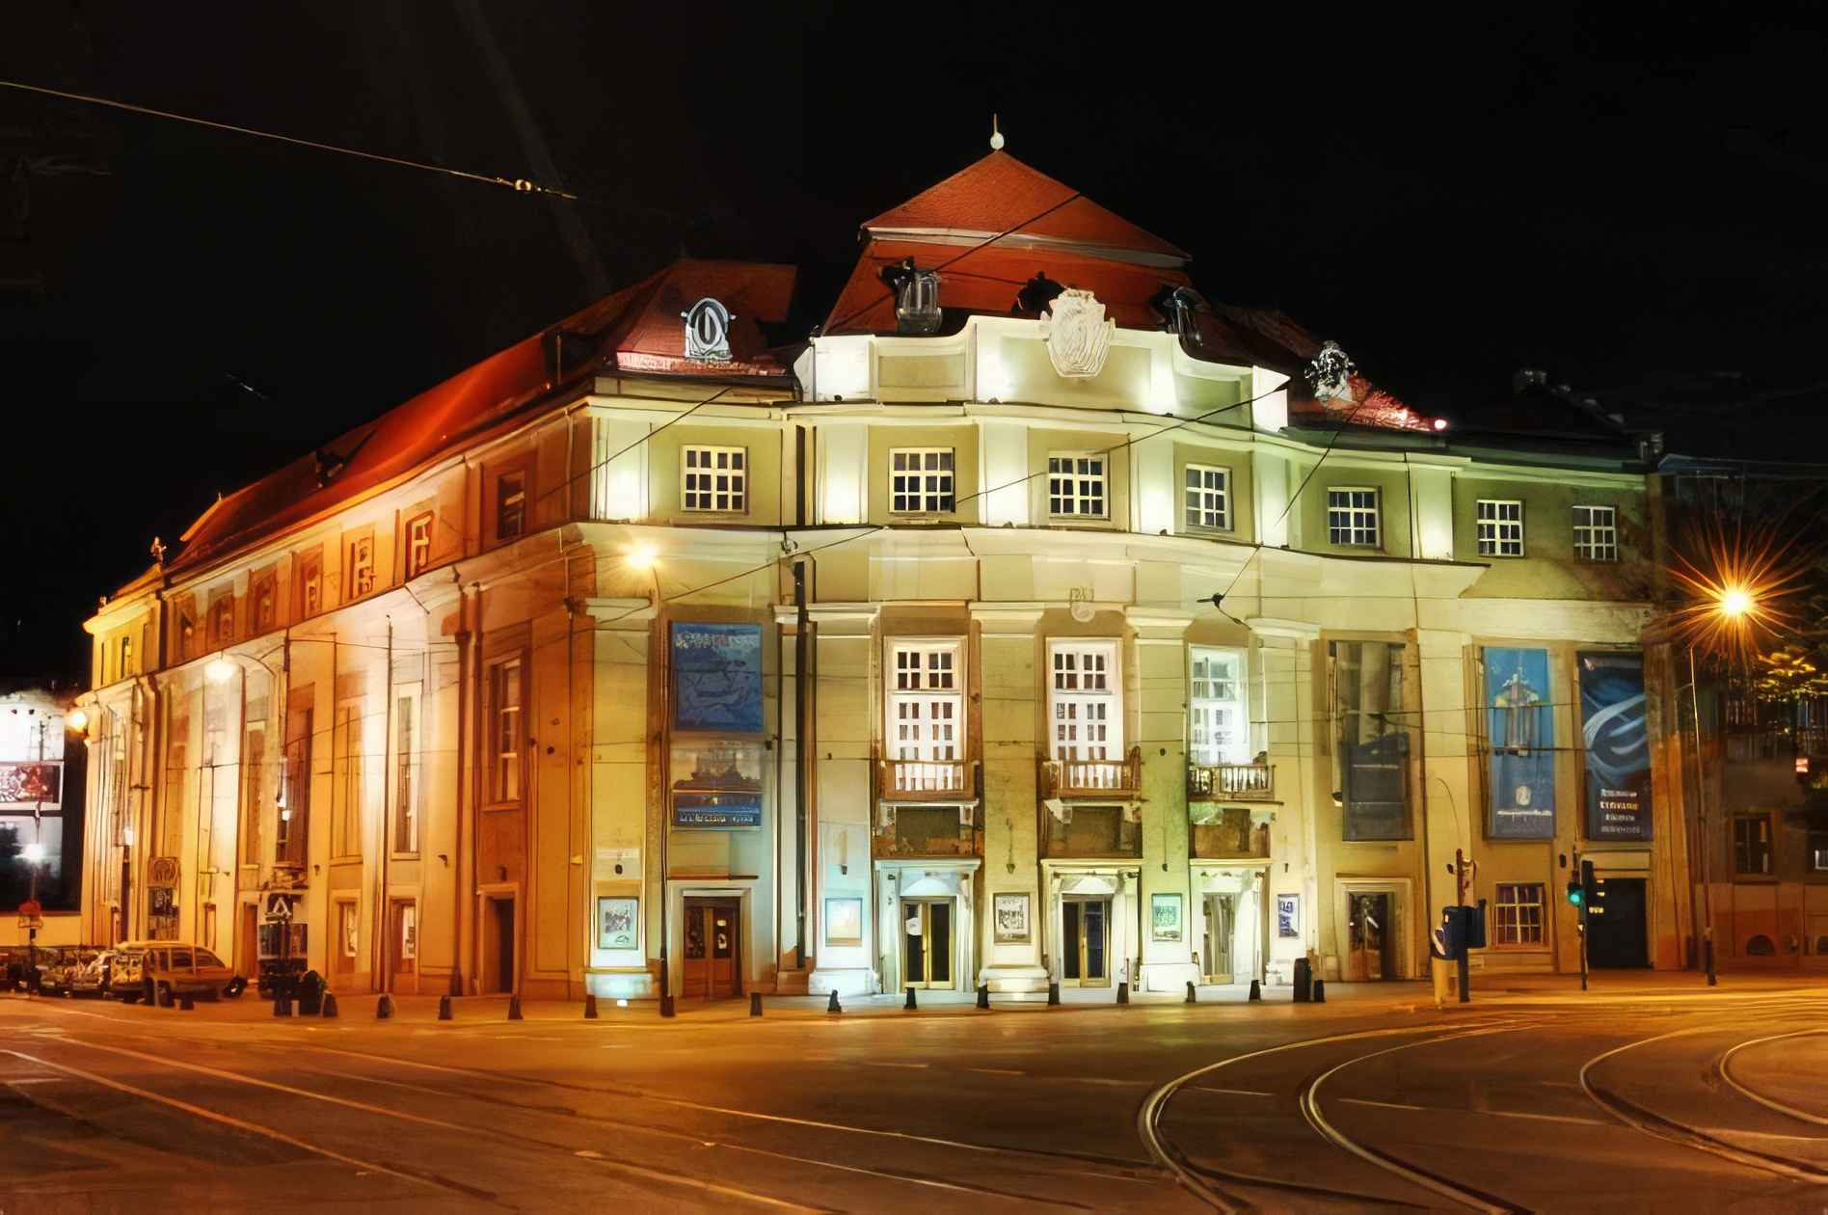
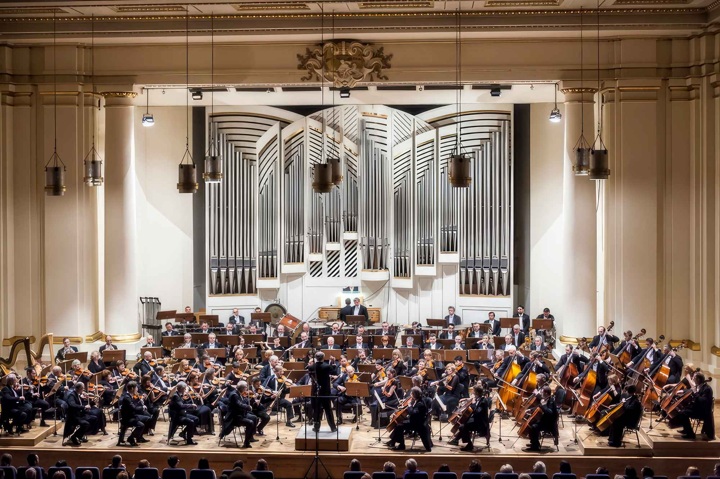
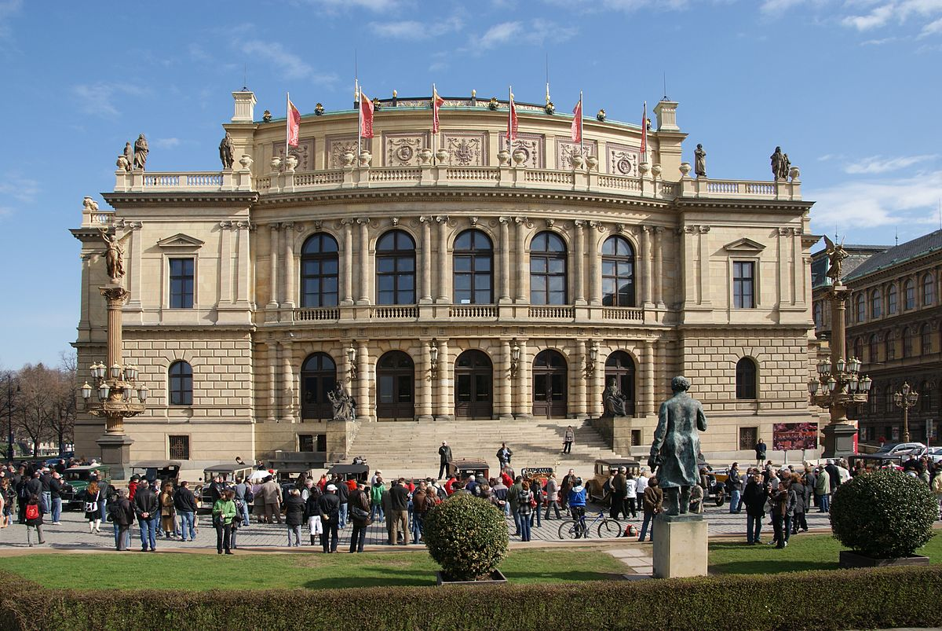
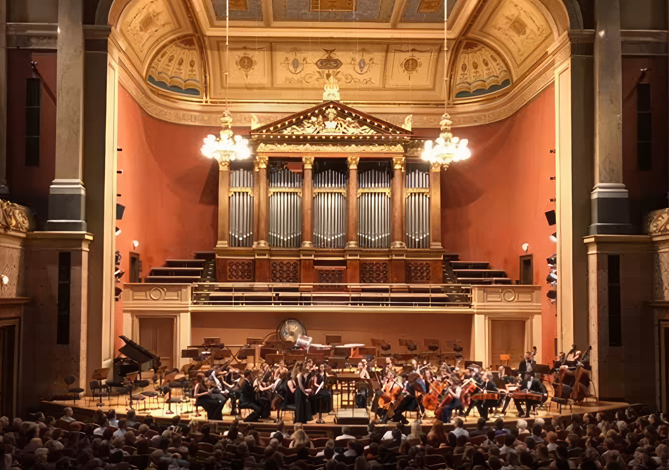
Performances in premiere concert venues include the
Krakow Philharmonic Hall and the Rudolfinum in Prague.

Slide 4
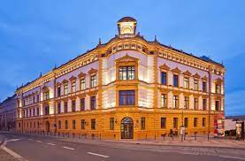
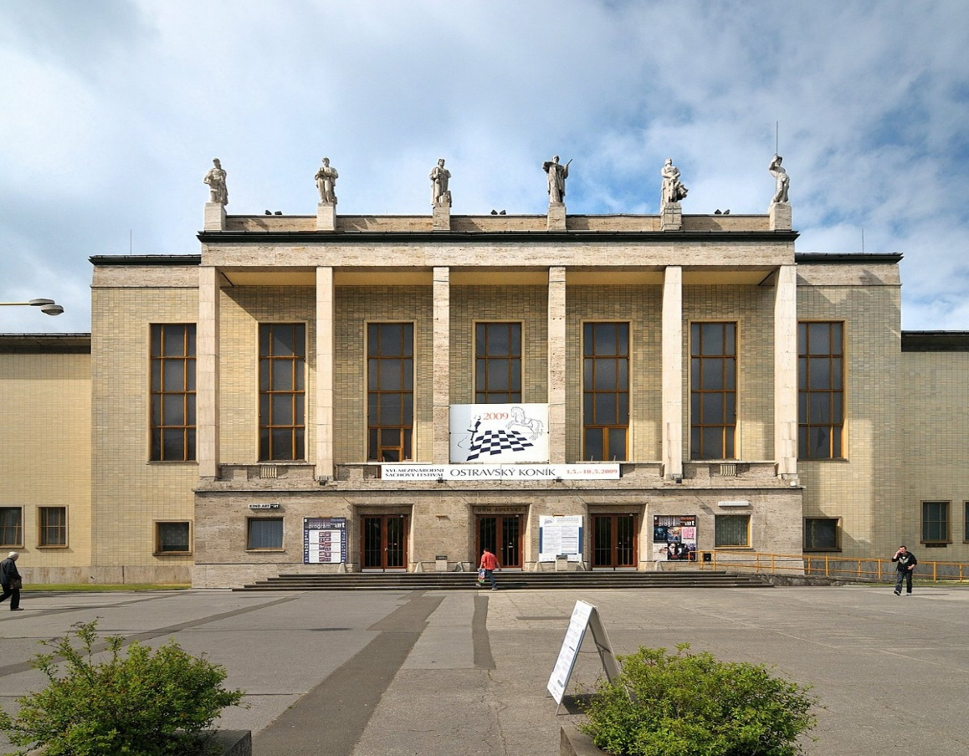
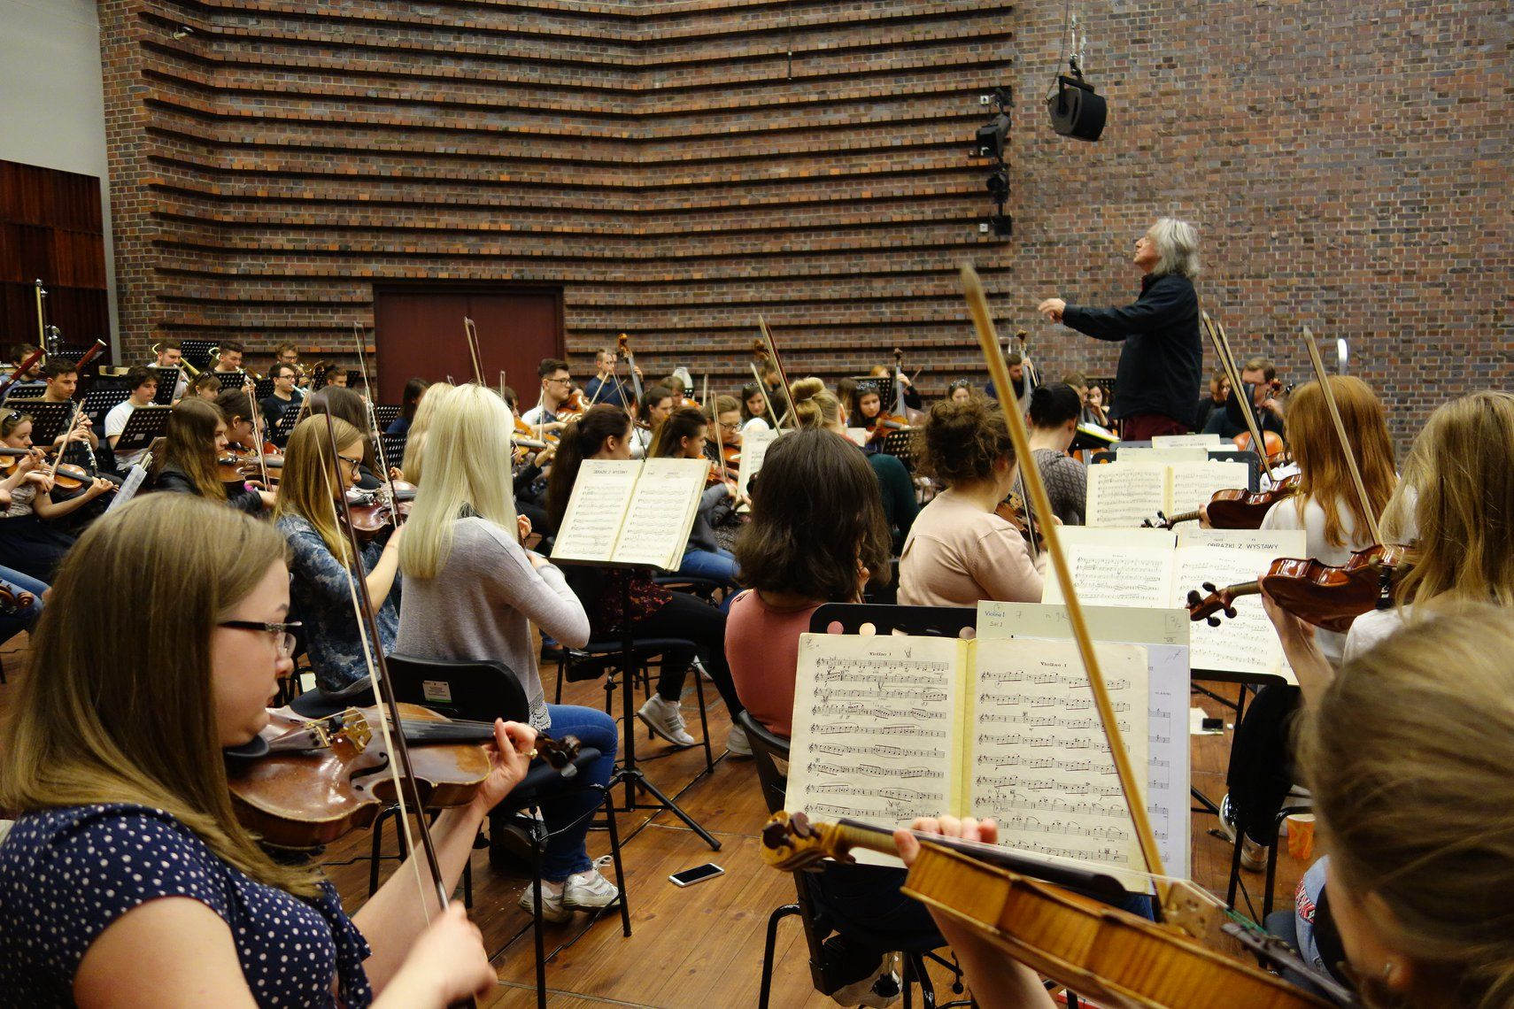
Additional performances at the Ostrava House of Culture
and Wroclaw Academy of Music.

Slide 5
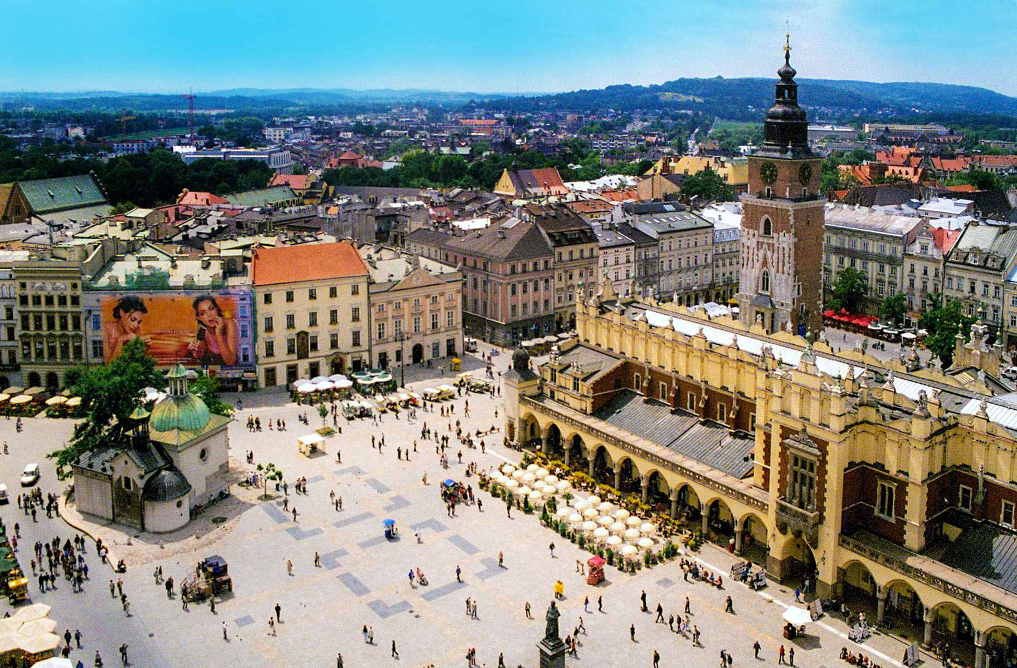
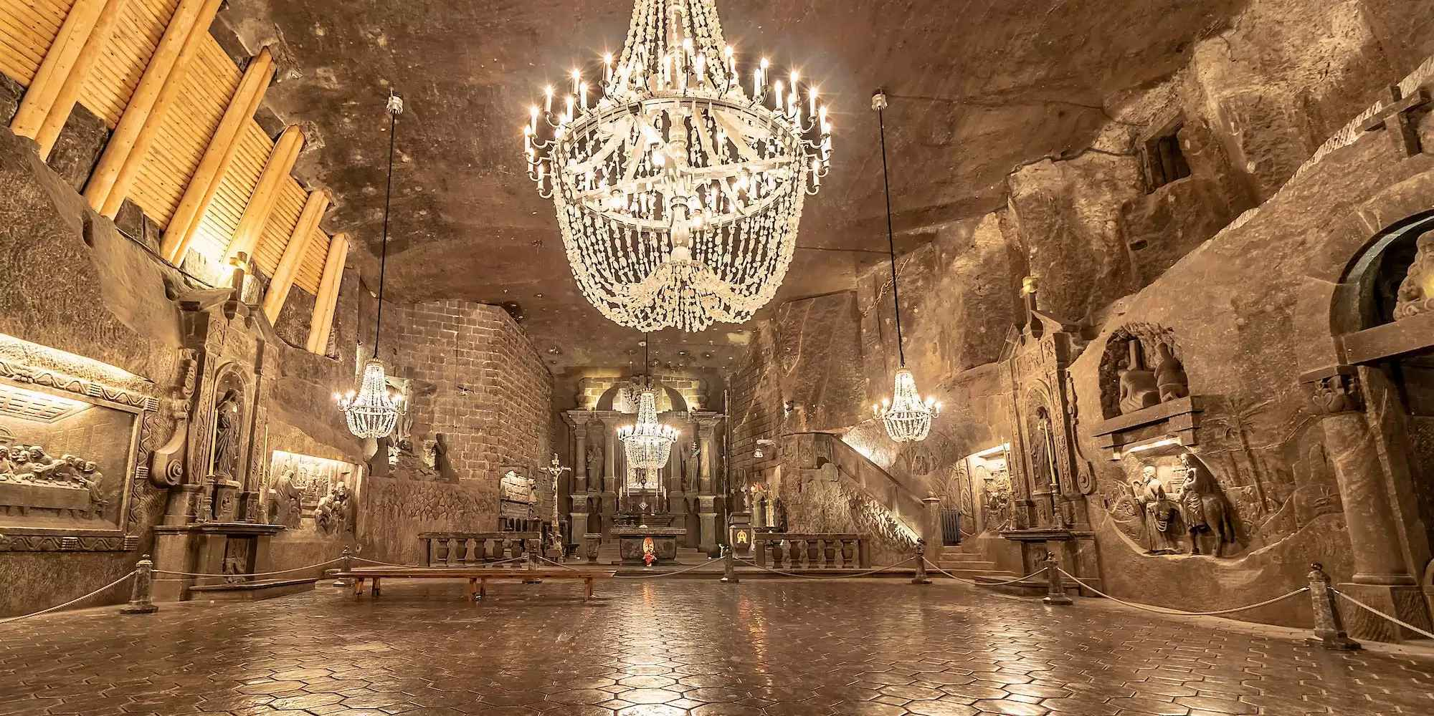
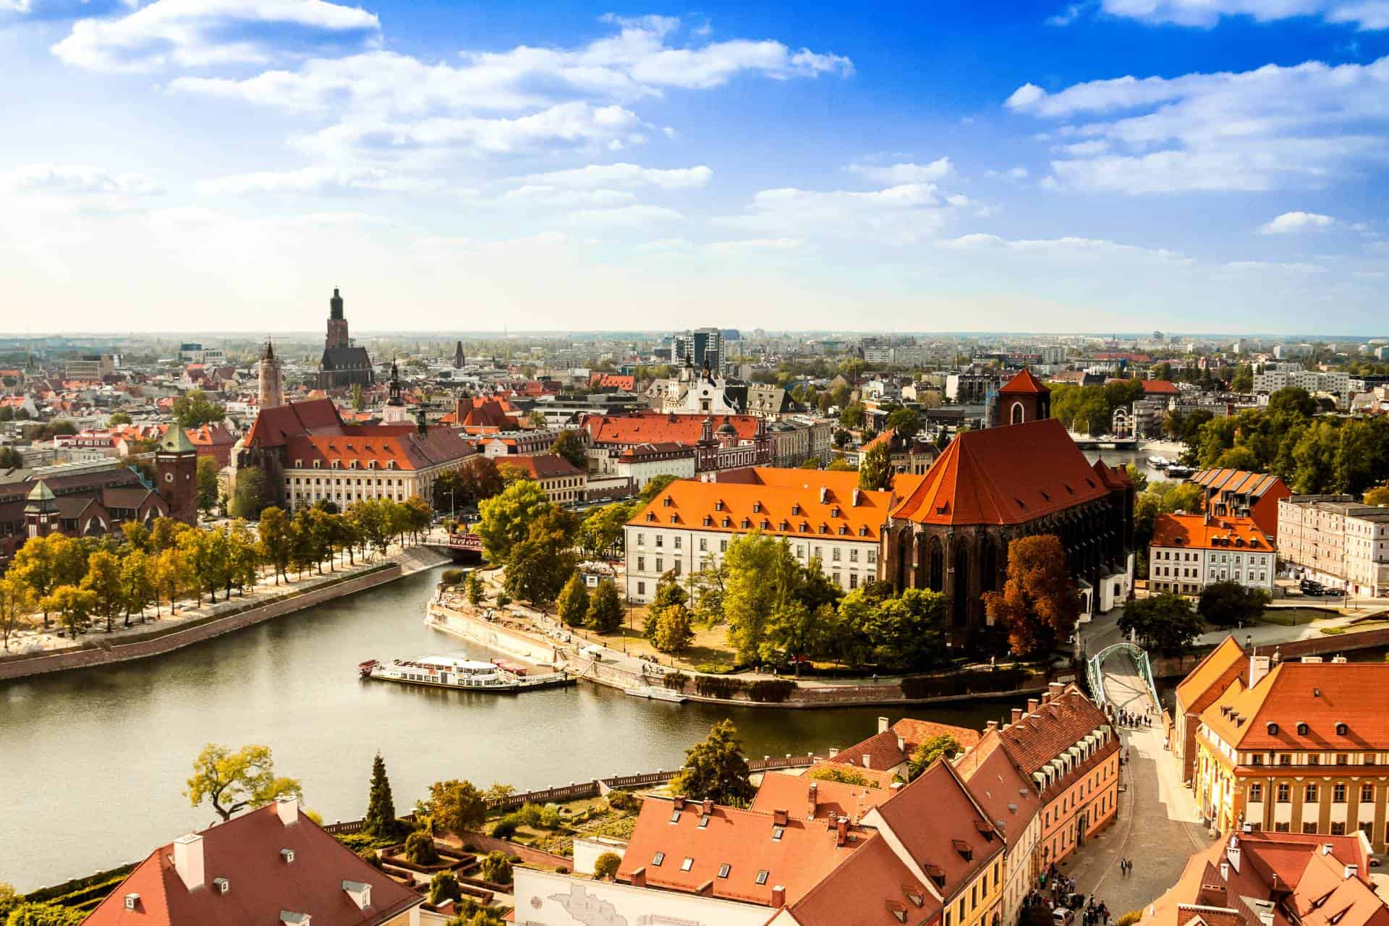
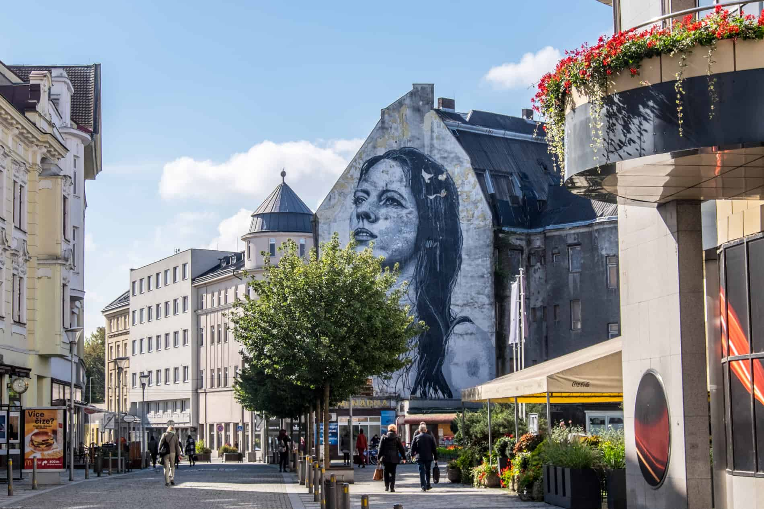
Sightseeing…
Wieliczka Salt Mines
Downtown Krakow
Historic Wroclaw
Madonna Street in Central Ostrava

Slide 6
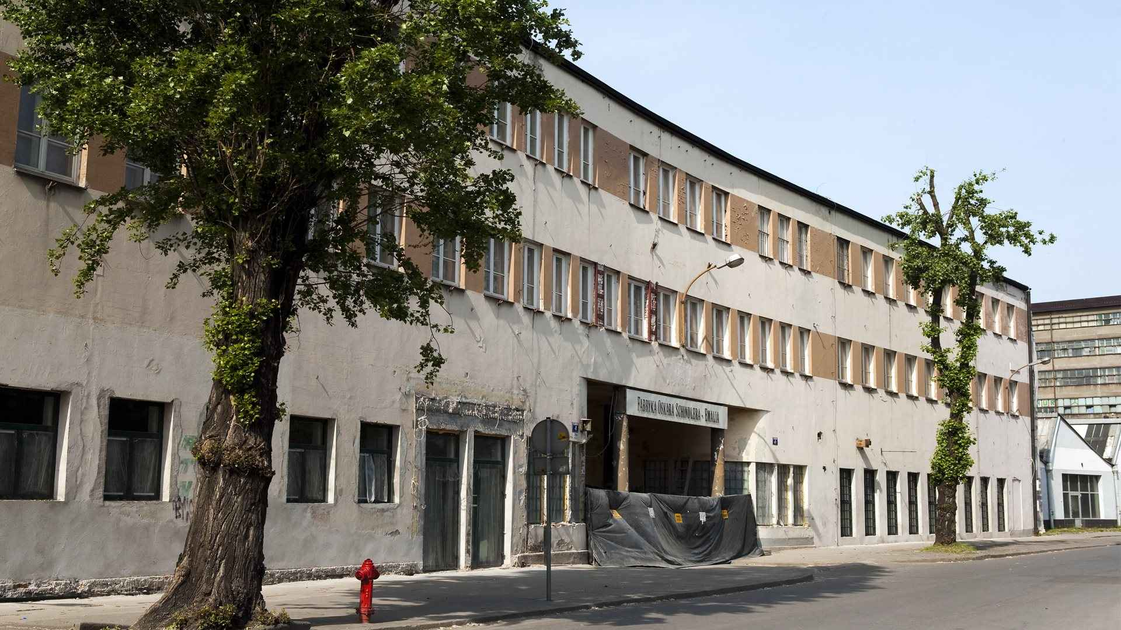
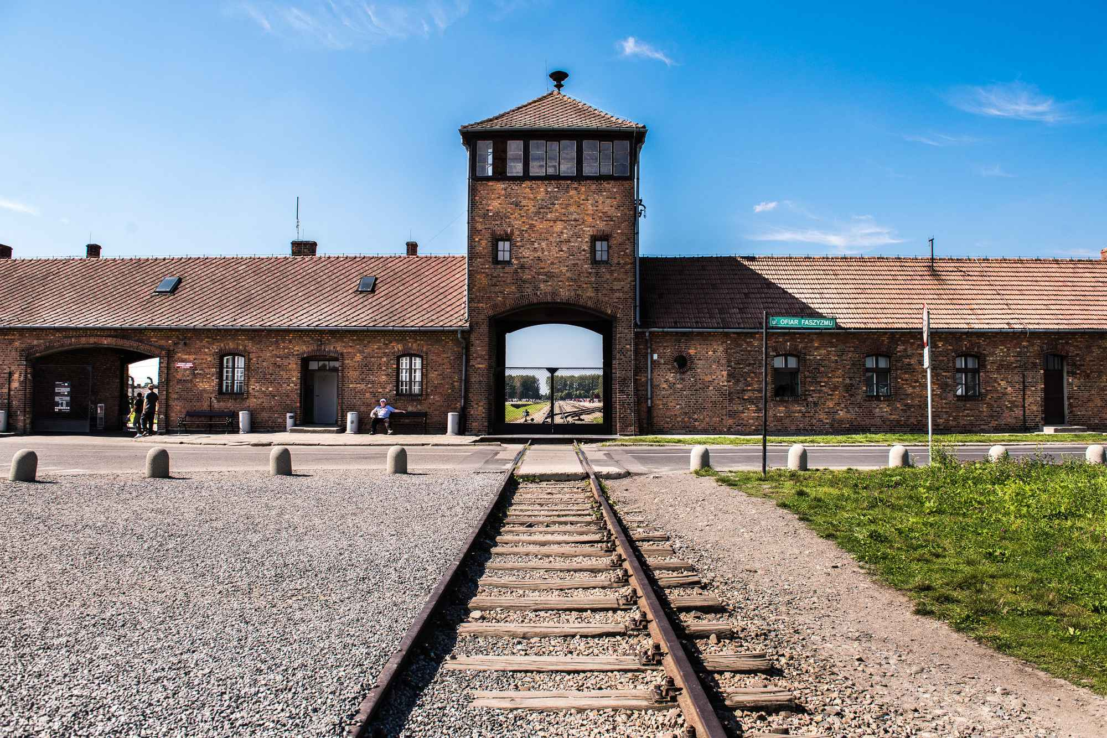
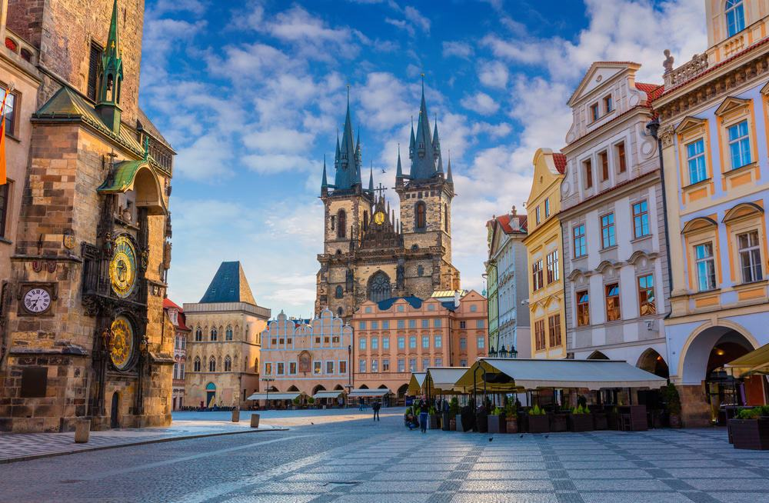
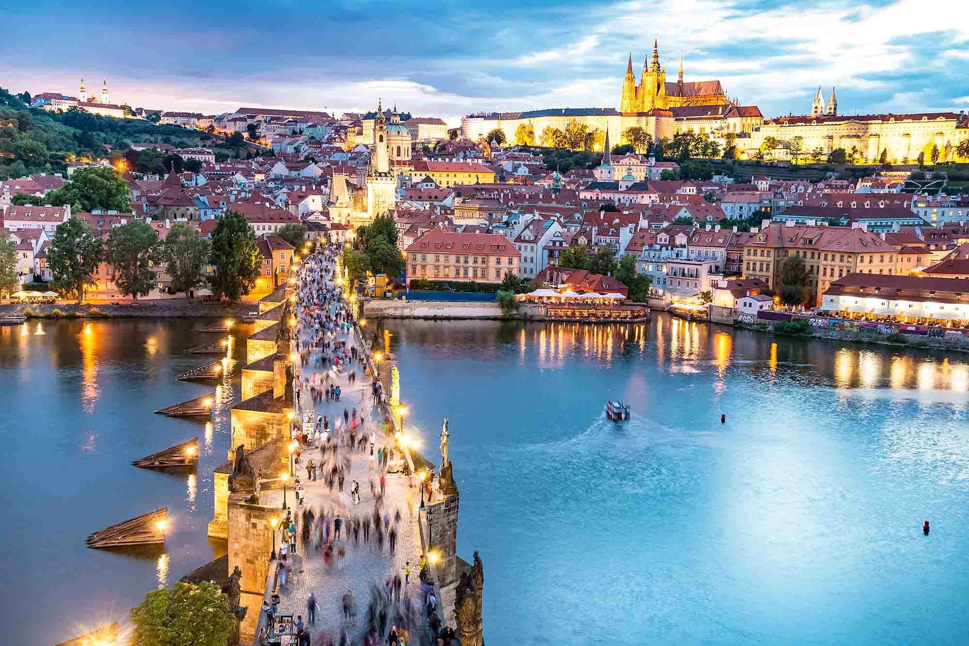
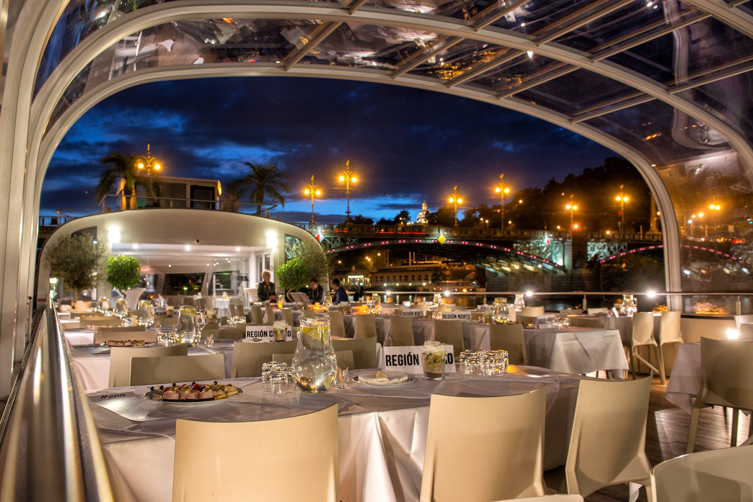
More sightseeing…
Schindler’s Factory
Auschwitz
Old Town Prague
Charles Bridge on the Vltava River
Evening boat cruise & dinner

Slide 7
I
Itinerary

Slide 10
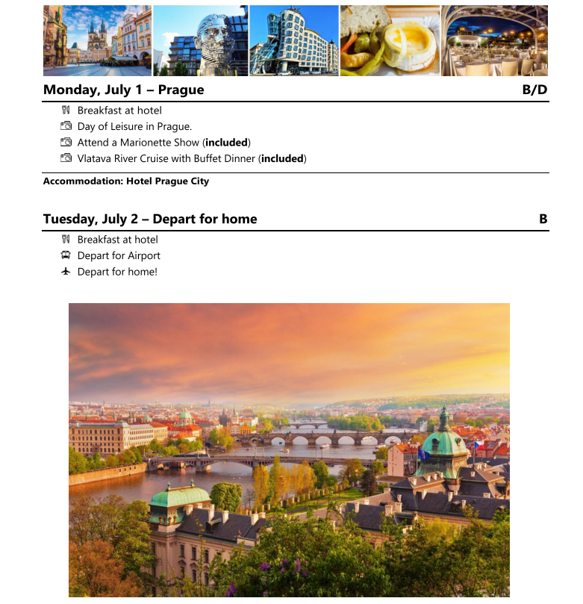

Slide 11
Trip Cost
Ground cost does not Include:
Airfare not included (see above)
Lunches & drinks at dinner
Passport Fees (everyone must have a passport book valid until at least 3 months, 6 months recommended after the last day of the tour)
ETIAS fee (7 euros)– required as of November 2023
Travel Medical Insurance (required)
Trip Cancellation Insurance (strongly recommended)
Single room supplement charge
Payment Deposit Schedule (per person):
$750 – May 1, 2023
$750 – Sept 29, 2023
$1,000 – Nov 17, 2023
$1,000 – Jan. 15, 2024
Balance – April 12, 2024
Cancellation Policy:
All Tour deposits and payments are non-refundable. We recommend participants purchase Cancel for Any Reason Insurance to protect their Investment.
Airfare Cost:
Airfare will be confirmed approximately 9 months prior to the tour. Because of the size, the group may be divided over different flights/airlines. Airfare estimate is between $1,500 - $2,000 per person.
Ground Cost: (airfare not included)
Room Type | Cost
Student (Based on Twin) | $2,870 per person
Chaperones (Based on Twin) | $2,295 per person
Single Supplement | $695 per person
Ground Cost includes:
Private Motor Coach throughout as per itinerary
Accommodation (based on twin). Single supplement is available.
Breakfast and dinner daily (not including drinks at dinner)
Performances and concert promotion as per itinerary
Sightseeing activities as per itinerary
Every effort will be made to accommodate food allergies and other reasonable food issues.
Rental of large instruments
Each Bus will be assigned a dedicated tour manager.
All Taxes & Gratuities

Slide 12
Shadow Tour
Culture Path will offer a shadow tour for the orchestra families
Cost will be similar to the student ground cost
Families will have multiple opportunities to share part of tour experience with musicians, including guaranteed seating at all performances
Hotel accommodations will be near musicians but at a different site
Information and sign-up link to the shadow tour will be sent out later this week

Slide 13
Additional Info & Reminders
Some limited funds will be made available by the Orchestra Boosters for financial assistance. Families in need of financial assistance will need to submit an application before the required deadline.
Fundraising opportunities will be made available to students to help defray individual trip costs.
Passports need to be valid at least 90 days beyond the intended date of departure. Apply early if you need to order them.
If applicable, plan ahead with flexible summer school options for students.

Slide 14
Possible Summer School Options
Fusion Academy – Personalized private school offers in-person and online programs. Website: www.fusionacademy.com
Opportunities for Learning – WASC-Accredited Public Charter High Schools offering free July Intersession program. Website: julyintersession.org
Study Hut / High Bluff Academy Partnership. Website: Studyhut.com
Please check with your counselors for approval on any classes taken at a non-MBX Summer School program

Slide 15
Trip Cancellation Insurance
MCM ARTS is not authorized to sell insurance. The information below is provided for information purposes only from Seven Corners Insurance. People should contact the insurance company of their choice directly for more information. You can contact Kendra Anderson, at 800-335-0611 or kendra.Anderson@sevencorners.com directly for more information.
Estimated Round Trip Choice Group Plan Cost Per Traveler: $4,501 - $5,000 as of 3/10/23
Age of Traveler | Standard Policy | +IFAR upgrade | +CFAR upgrade | +CFAR & IFAR
0-34 | $209 | $215.27 | $296.78 | $303.05
35-55 | $280 | $288.40 | $397.60 | $406
56-70 | $457 | $470.71 | $648.94 | $662.65
Interruption For Any Reason (IFAR)
IFAR allows you to claim for up to 75% of unused, forfeited prepaid non-refundable payments, as well as transportation costs to either re-join your trip or return home early for a non-covered reason.
Interruption of Trip must be made at least 2 days after Trip Start for benefits to apply.
Meeting these required conditions allows the traveler to interrupt their trip for any reason (homesick, pet is sick, war breaks out).
RoundTrip Group Plan Highlights
Trip Cancellation - Up to 100% reimbursement of the non-refundable trip costs
Trip Interruption - Up to 150% of trip cost for non-refundable and incurred expenses
Primary Medical Coverage - up to $500,000 (Treatment for Covid-19 included)
Emergency Evacuation and Repatriation - benefits up to $1,000,000
Trip Delay - benefit that goes up to a maximum of $2,000 per person
Baggage Delay - up to $500 to purchase clothes/toiletries/essentials
Cancel for Any Reason (CFAR)
CFAR allows you to cancel your trip for a non-covered reason and receive reimbursement of up to 75% of the non-refundable trip costs.
The trip must be cancelled at least 2 days prior to the Trip Start date for benefits to apply.
The CFAR upgrade would allow the traveler to cancel for any reason (vaccine requirements change, border closures, don't want to go, etc.) when they meet these required conditions.

Slide 16
Next Steps
Trip Commitment form is available tonight
Commitment Form and 1st and 2nd non-refundable deposits due date is Friday, September 29th
Return the form/deposits to Mr. Park

